Slide 1

D365 CE 2023 Release waves

Slide 2

Customer Service
02

Slide 3





Customer Service
2023
Wave Release 1
Administrator experiences
An intuitive, modern administration experience is key to quickly setting up D365 Customer Service and using its features.
Agent experiences
Enable agents to handle multiple interactions, interact with multiple apps without losing context, and enhance workflows with productivity tools.
Copilot and AI innovation
Copilot in D365 Customer Service consists of a range of AI capabilities that can expedite the resolution of customer issues and increase satisfaction.
Omnichannel
Enables instant engagement and connectivity between agents and customers and gives supervisors real-time visibility into operational efficiency.

Slide 4

Customer Service
2023
Wave Release 1
Supervisor experiences
Enable supervisors to monitor and improve contact centre operations.
Teams integration
Provide agents with seamless integrations between Dynamics 365 and Microsoft Teams.
Unified routing
Intelligent work item classification and omnichannel routing capabilities enable the flexibility and automation of AI-enabled workflows.

Slide 5



Administrator experiences
Customer service
Assign agent experience profiles based on security roles
Administrators can use agent experience profiles to create custom profiles with specific session templates, conversation channels, and productivity tools.
The profiles can then be assigned to all users as a default profile or mapped to security roles.
Set a custom agent experience profile as the default profile.
Associate an agent experience profile with a security role.
Public Preview: -
Early Access: -
General Availability: 1 Apr, 2023

Slide 6
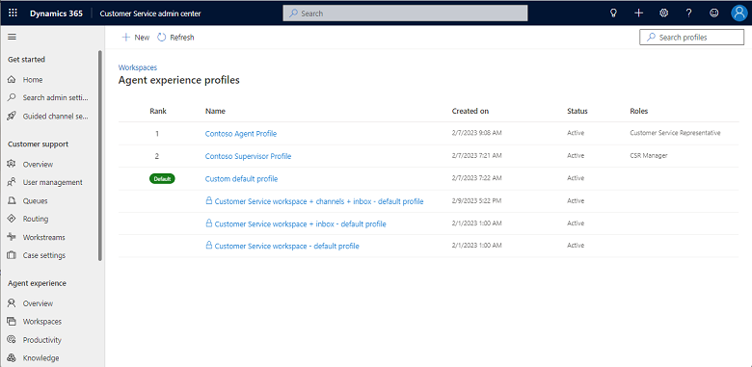
Administrator experiences
Customer service
Assign agent experience profiles based on security roles

Slide 7
Administrator experiences
Customer service
Apply company branding with live chat widget 2.0
With the new unique script-based UI customization, you can instantly allow your developers to edit the design of the out-of-the-box chat widget.
To create a custom chat widget, the functionalities and characteristics are now easier to modify by developers.
Combined chat SDK stack with UI components library.
Increased structure for custom developers by adding a UI framework.
Centralized areas of functionalities with their UI counterparts to increase the usability of the packages.
Improved performance of live chat widget functionalities.
Public Preview: 1 Mar 2023
Early Access: -
General Availability: 21 Apr 2023

Slide 8
Administrator experiences
Customer service
Improved admin experience to help increase productivity
Use customer feedback to continually evolve the admin experience and improve productivity.
Access recommended features that are enabled by default for chat, voice, and other digital messaging channel setup wizards.
Reorder rules by dragging them in route-to-queues ruleset workstreams.
Easily access security roles management rights in user management.
Add an email signature for the productivity landing page.
Public Preview: -
Early Access: -
General Availability: 30 Apr 2023

Slide 9
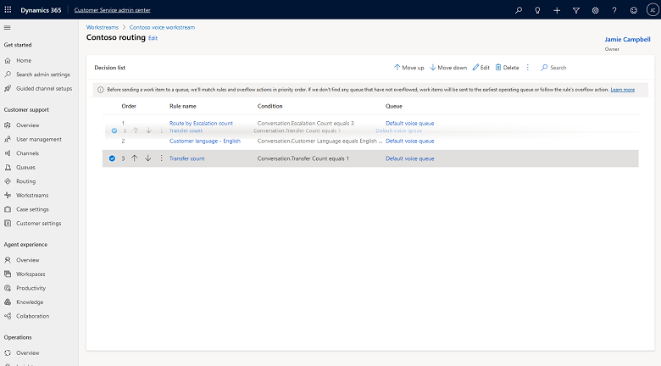
Administrator experiences
Customer service
Improved admin experience to help increase productivity

Slide 10
Administrator experiences
Customer service
Integrate and search external knowledge sources
Having the ability to identify the most relevant and contextual content across knowledge sources will help agents find the most suitable solution for your customers easily.
View a consolidated list of relevant search results from Dataverse and external sources for their search query.
View the list of relevant search results provided in a single ranking across data sources.
Public Preview: 1 Mar 2023
Early Access: -
General Availability: 30 Apr 2023
Notes:
Configure data from external data sources.
Set up a data refresh schedule to specify the refresh frequency of the ingestion service that will capture newly created or updated articles and also any data that might have been missed during syncing and ingestion.

Slide 11
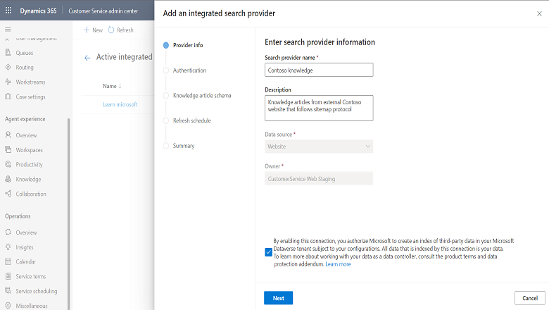
Administrator experiences
Customer service
Integrate and search external knowledge sources

Slide 12
Administrator experiences
Customer service
Data model customization for Omnichannel real-time analytics
Administrators can define metrics and track them in real time against contact centre goals.
In scenarios where the out-of-the-box Omnichannel real-time metrics don't fit your business needs, you can use data model customization to add new custom metrics or derived metrics.
As administrators, provision out-of-the-box reports and data models in their Power BI tenant.
As administrators and report authors, extend the out-of-the-box data models by bringing in custom entities from Dataverse or any other data source.
Add new metrics in addition to the out-of-the-box metrics.
Build new customized reports targeting the extended data model.
Embed the customized Power BI report on the Customer Service workspace application.
Public Preview: -
Early Access: -
General Availability: 9 Jun 2023
Notes:
This feature will be released into the following Microsoft Azure geographic areas:
United States
Europe
Asia Pacific
United Kingdom
Australia
South America
Canada
India
Japan
France
Korea

Slide 13
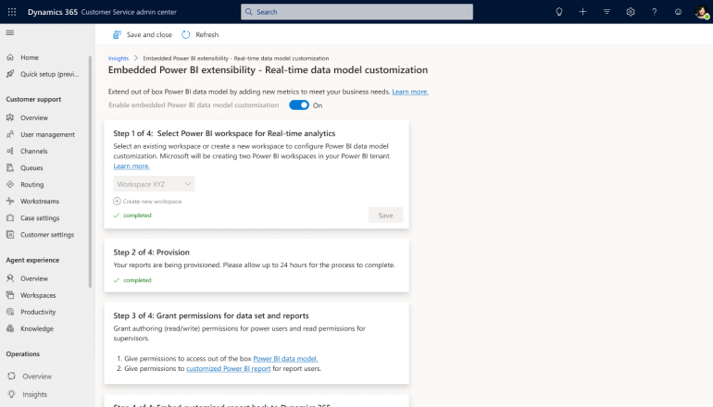
Administrator experiences
Customer service
Data model customization for Omnichannel real-time analytics

Slide 14
Administrator experiences
Customer service
Improved onboarding of Power Virtual Agents bots
The bot handoff with the omnichannel experience has been simplified by adding it to the Customer Service admin centre.
Now, the admins don't have to go to Power Virtual Agents to configure the bots that need to be used in Omnichannel for Customer Service.
Improved agent transfer setup experience for the Power Virtual Agents bot with Omnichannel for Customer Service.
Manage your bots on the Bots page that's now available in the Customer Service admin centre.
Easy onboarding of the Power Virtual Agents bot in the guided channel setup wizard.
Public Preview: -
Early Access: -
General Availability: Jun 2023

Slide 15
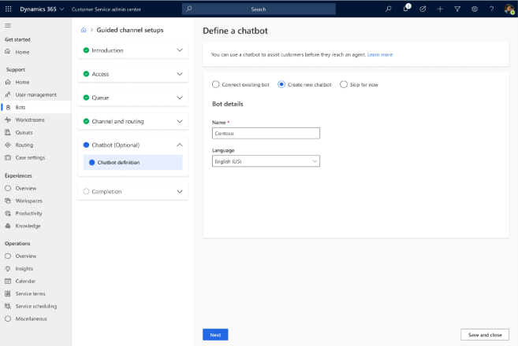
Administrator experiences
Customer service
Improved onboarding of Power Virtual Agents bots

Slide 16
Administrator experiences
Customer service
Set up Customer Service features in one click
In the Customer Service admin centre, you can set up features in Customer Service like live chat and voice channels in just a single click with the recommended agent experience and insights features.
Ready-to-use contact centre with chat and voice channels set up with the smart defaults.
Agent experience profile for the best multisession experience.
Out-of-the-box availability of recommended reports and AI features.
Power tours that highlight how we have set up the capabilities for you.
Links to related admin apps, like Power Platform admin centre, on the home page.
Public Preview: -
Early Access: -
General Availability: Jun 2023

Slide 17
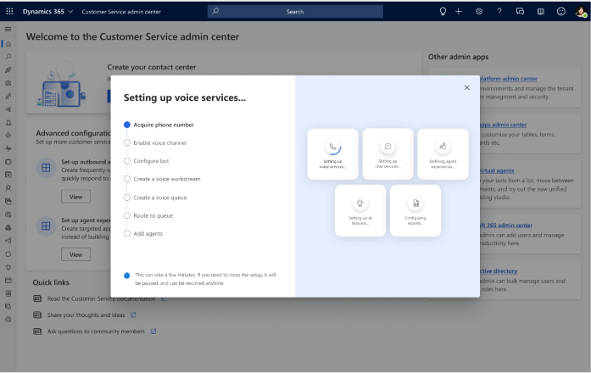
Administrator experiences
Customer service
Set up Customer Service features in one click

Slide 18
Administrator experiences
Customer service
Customize data models of historical analytics reports
With this feature, administrators have the ability to extend the out-of-the-box Customer Service Power BI data model and integrate with other data sets to produce new custom metrics.
Administrators can provision out-of-the-box reports and data models in your Power BI tenant.
Administrators and report authors can extend out-of-the-box data models by bringing in custom entities from Dataverse or from any other data source.
Add new metrics in addition to the out-of-the-box metrics.
Build new customized reports targeting the extended data model.
Embed the customized Power BI report into the Customer Service workspace application.
Public Preview: 31 Oct 2022
Early Access: -
General Availability: 30 Jun 2023

Slide 19
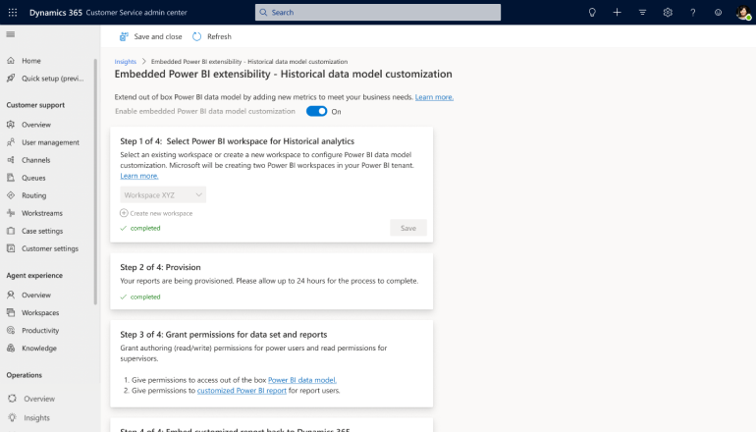
Administrator experiences
Customer service
Customize data models of historical analytics reports

Slide 20
Administrator experiences
Customer service
Leverage enhancements to the activity monitor tool
In instances where an email doesn't get converted to a case, administrators expect the system to show the reason for the failure along with recommendations to resolve the issue.
These suggested actions in the activity monitor tool help admins solve their issues independently.
View the additional column in Activity monitor view, with suggested actions for each event, and resolve customer issues quickly.
Review recommendations and fix customer issues independently.
Public Preview: -
Early Access: -
General Availability: Sep 2023

Slide 21
Administrator experiences
Customer service
Summary
Feature | Public Preview | Early Access | General Availability
Assign agent experience profiles based on security roles | - | - | 1 Apr 2023
Apply company branding with live chat widget 2.0 | 1 Mar 2023 | - | 21 Apr 2023
Improved admin experience to help increase productivity | - | - | 30 Apr 2023
Integrate and search external knowledge sources | 1 Mar 2023 | - | 30 Apr 2023
Data model customization for Omnichannel real-time analytics | - | - | 9 Jun 2023
Improved onboarding of Power Virtual Agents bots | - | - | Jun 2023
2023 Release Wave 1

Slide 22
Administrator experiences
Customer service
Summary
Feature | Public Preview | Early Access | General Availability
Set up Customer Service features in one click | - | - | Jun 2023
Customize data models of historical analytics reports | 31 Oct 2022 | - | 30 Jun 2023
Leverage enhancements to the activity monitor tool | - | - | Sep 2023
2023 Release Wave 1

Slide 23
Agent experiences
Customer service
Create and manage cases efficiently with enhanced case form
Agents can upload multiple attachments and take quick notes, while creating a case with the enhanced case form.
This enables them to perform their daily case management operations with less effort and increases productivity.
Find information quickly and manage cases efficiently by leveraging the streamlined case form.
Add key information to the case without losing sight of customer details, past cases, and previous interactions. This avoids case duplication.
Add updates on existing customer cases without interrupting the case creation flow or switching tabs.
Take notes during case creation.
Upload multiple attachments directly to the case.
Use the Description field with RTE capabilities to capture rich case details.
Access all the attachments related to a case in a consolidated view.
Public Preview: -
Early Access: -
General Availability: 1 Apr 2023

Slide 24
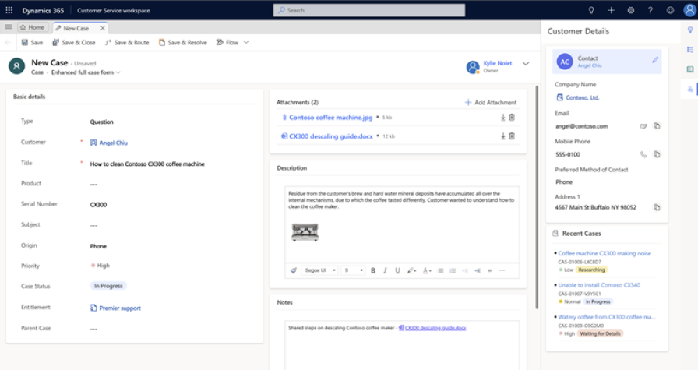
Agent experiences
Customer service
Create and manage cases efficiently with enhanced case form

Slide 25
Agent experiences
Customer service
Find email templates faster with enhanced template selection
With this feature, agents can find the templates faster by using preconfigured views of templates that have persisting filters.
The record selector dialog box will be integrated in the selection pane to reduce the clicks required to select an email template, thereby reducing the time to select an email template and improving agent productivity.
Use preconfigured views of templates to find the right template quickly.
Switch between views of templates that have persisting filters.
Reduce extra clicks and time with the integrated record selection in the template selection dialog box.
Public Preview: -
Early Access: -
General Availability: 1 Apr 2023

Slide 26
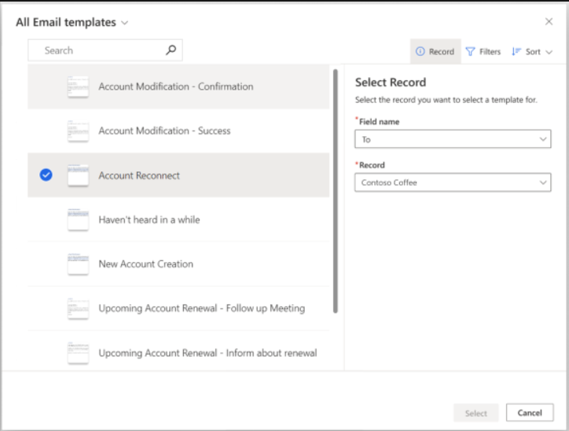
Agent experiences
Customer service
Create and manage cases efficiently with enhanced case form

Slide 27
Agent experiences
Customer service
Keep track of conversations with AI-generated summaries
Using these AI-generated summaries, you can quickly share context about the customer's issue and the resolutions tried.
With structured context, you can collaborate with other agents and subject matter experts to resolve the customer's problem faster and more effectively.
Refinements to the generated summaries.
Enhancements to the summary user interface.
Improved feedback collection.
Public Preview: 1 Oct 2022
Early Access: -
General Availability: 1 Apr 2023

Slide 28
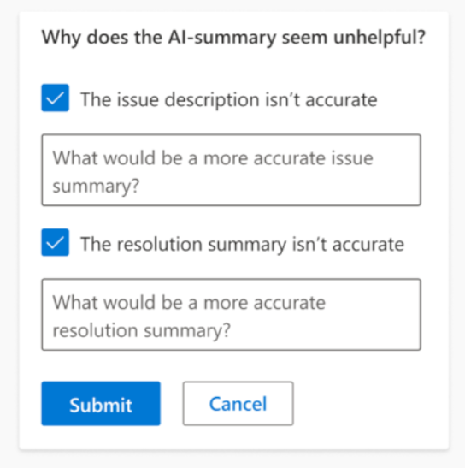
Agent experiences
Customer service
Keep track of conversations with AI-generated summaries

Slide 29
Agent experiences
Customer service
Create email templates with new template designer
They help save time and provide a way to create consistent, professional, preformatted email messages that can be used when communicating with customers.
You can create, view, and edit the email templates.
The new email template creation experience provides an advanced, digital content designer for creating and styling templates.
It includes advanced layouts that are responsive and adapt to any screen size.
Users can add elements like images, text, buttons or dividers easily while creating email templates.
Public Preview: -
Early Access: 6 Feb 2023
General Availability: 1 Apr 2023

Slide 30
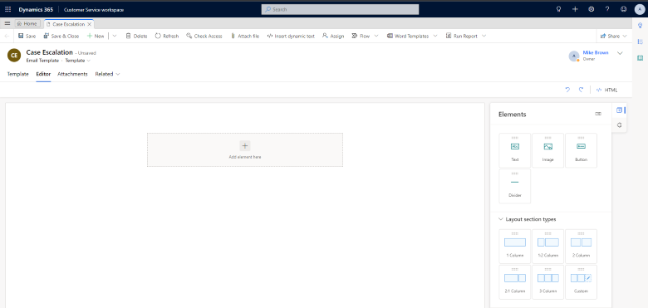
Agent experiences
Customer service
Create email templates with new template designer

Slide 31
Agent experiences
Customer service
Enhanced transcript viewer available by default
Agents will experience the new view by default because the enhanced transcript viewer helps in better adaptive card rendering with clearer spacing and cut-off points in the conversation.
The enhanced transcript viewer is enabled out of the box.
For a cohesive agent experience, we have brought about feature parity in the transcript viewer for both voice and digital messaging channels.
Public Preview: -
Early Access: 6 Feb 2023
General Availability: 1 Apr 2023

Slide 32
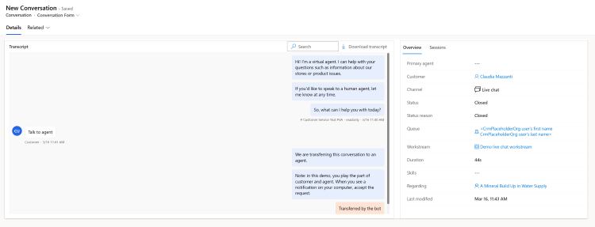
Agent experiences
Customer service
Enhanced transcript viewer available by default

Slide 33
Agent experiences
Customer service
Enhancements simplify case management
Color-coded case status and icons for priority help agents find the required information quickly, visualize key information, and prioritize cases accordingly.
The enhanced process of adding a case to a queue helps agents understand the queue to which a case belongs, saving them multiple clicks, and displays only relevant queues to which a case can be added.
Color-coded priority icons.
Color-coded case statuses for easy discoverability.
Improved process of adding a case to a queue.
The Worked by field on the case displays a filtered list of members belonging to the private queue to which a case is added.
Enhanced case resolution process.
The improved case resolution dialog box offers a clutter-free experience to the users.
Public Preview: -
Early Access: 6 Feb 2023
General Availability: 1 Apr 2023

Slide 34
Agent experiences
Customer service
Mark knowledge articles as favourite
Agents can mark articles as favourite and access these at your convenience.
Agents can also add or remove articles from the favourite list to keep the list relevant.
Add or remove articles from the favourite list.
View favourite articles in the form-embedded knowledge search control, app-side-panel-based knowledge search control, and independent knowledge search control.
Public Preview: -
Early Access: 6 Feb 2023
General Availability: 1 Apr 2023

Slide 35
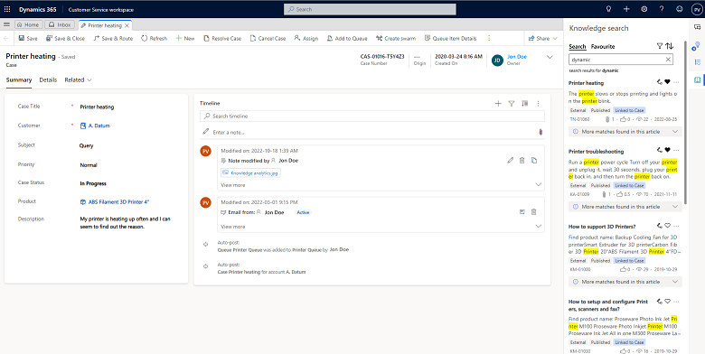
Agent experiences
Customer service
Mark knowledge articles as favourite

Slide 36
Agent experiences
Customer service
Multitask efficiently with enhanced workspace layout
Customer Service workspace enables agents to multitask by switching seamlessly between cases, conversations, and issues, without losing the context of the work that's in progress.
The modern design of the Customer Service workspace app has a new layout for the site map, sessions, and tabs.
Sessions and child tabs are displayed horizontally and improved handling of overflow tabs and sessions with tab bar visible only if multiple tabs are present in a session.
Improved site map that's accessed from the Menu with support for grouping and areas.
Improved accessibility with 400 percent zoom mode and increased predictability of session closure in multisession apps.
In-app notifications aligned with the multisession navigation.
Public Preview: -
Early Access: 6 Feb 2023
General Availability: 1 Apr 2023

Slide 37
Agent experiences
Customer service
Improve agent productivity in timeline
New timeline enhancements help agents improve productivity and save time when they help customers by making it easier to capture notes and view content.
Choose a timeline layout between roomy and cozy.
Copy a note using the copy-to-clipboard command.
See consolidated inline images and files in the notes.
Public Preview: -
Early Access: -
General Availability: 7 Apr 2023

Slide 38
Agent experiences
Customer service
Filter work items by read or unread
Agents can maintain visibility of new activity on work items.
Mark work items to revisit later.
Work items can be filtered by read or unread status in the inbox.
Cards will show work items as read or unread using visual indicators.
Work items can be manually marked as read or unread by selecting a button.
A number of unread work items is displayed next to each view.
Public Preview: -
Early Access: 6 Feb 2023
General Availability: 5 May 2023

Slide 39
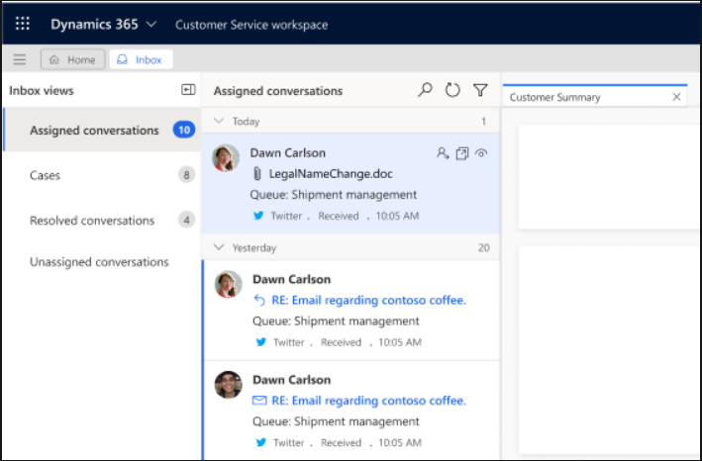
Agent experiences
Customer service
Filter work items by read or unread

Slide 40
Agent experiences
Customer service
See inbox improvement with collapsible left panel
Agents will be able to navigate to any view assigned to their profile and sort those views with minimal action.
Increasing the speed with which they can identify work items assigned to them and monitor their workload will help improve the time to resolution.
The customer service agent who has an inbox-enabled profile signs into the Customer Service workspace, and then selects the Inbox tab.
The agent sees the inbox with left panel expanded by default, and the first view on the list is displayed.
When the agent leaves the inbox and then returns, the left pane is still in the state (collapsed or expanded) that they left it in.
Public Preview: -
Early Access: 6 Feb 2023
General Availability: 5 May 2023

Slide 41
Agent experiences
Customer service
Access improved active conversation form
The workspace enables agents to multitask on several cases and conversations simultaneously and the ability to switch between issues without losing context.
Enhanced Customer Details with inline edit capability.
Enhanced Case Details with inline edit capability.
Enhanced Recent cases control.
Improved form layout.
Public Preview: -
Early Access: -
General Availability: 31 May 2023

Slide 42
Agent experiences
Customer service
Customize active conversation form
Access to relevant information while interacting with the customers helps agents understand the conversation context better and avoid navigating to other screens.
During customer conversations, agents might also want to view information stored in external systems to solve customer issues quickly.
Administrators can add custom fields and drag and drop them on the active conversation form (formerly known as the customer summary) using Power Apps.
While interacting with customers, agents can view data on the fields when the form loads.
Agents can update custom and selected standard fields and save the updates on the form.
Agents can access external data on the form using Canvas apps.
Public Preview: -
Early Access: -
General Availability: 1 Jun 2023

Slide 43
Agent experiences
Customer service
Improve agent productivity with modernized case grids
With this feature, they can view the key KPIs like SLAs and Case Age on the case grid, perform inline edits without navigating to the case form, visualize information like priority and origin with their icons, and navigate to the latest interaction for the case in a single step.
Visualize information like priority and the origin channel with their icons and agents assigned to the cases with their avatars.
View key KPIs, such as case age, next SLA breach, and latest activity to make faster decisions.
Perform inline edits and use quick navigation to respond to the latest communication.
Public Preview: 31 Jul 2022
Early Access: -
General Availability: 1 Jul 2023

Slide 44
Agent experiences
Customer service
Relate notes and create entities from notes
This update provides flexibility for agents to create a case from a note on the timeline without requiring extra steps.
Create an entity record from a note on the timeline. Entities that are currently supported are case, account, and contact.
Relate the note from one entity record to another: Agents can transfer the note they took on an account or contact timeline to an existing case.
Public Preview: -
Early Access: -
General Availability: Jul 2023

Slide 45
Agent experiences
Customer service
Forecast agent demand to handle customer conversations
In this release, we will provide more granular agent forecasts at 15-minute intervals that customer service managers can use to create agent schedules for voice and digital channels.
Customer service managers can also forecast the number of agents needed to handle forecasted conversation volumes at 15-minute intervals.
Public Preview: 28 Apr 2023
Early Access: -
General Availability: TBA

Slide 46
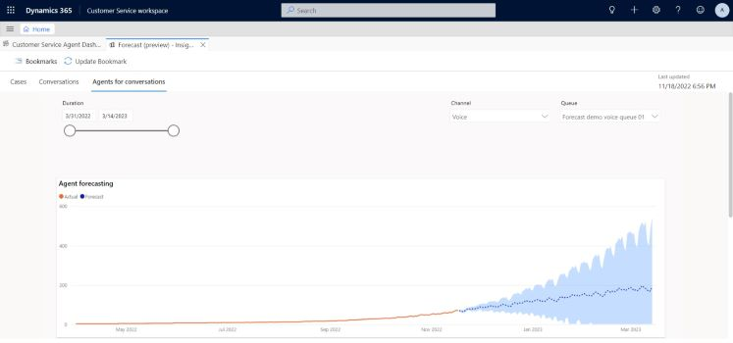
Agent experiences
Customer service
Forecast agent demand to handle customer conversations

Slide 47
Agent experiences
Customer service
Summary
Feature | Public Preview | Early Access | General Availability
Create and manage cases efficiently with enhanced case form | - | - | 1 Apr 2023
Find email templates faster with enhanced template selection | - | - | 1 Apr 2023
Keep track of conversations with AI-generated summaries | - | - | 1 Apr 2023
Create email templates with new template designer | - | 6 Feb 2023 | 1 Apr 2023
Enhanced transcript viewer available by default | - | 6 Feb 2023 | 1 Apr 2023
Enhancements simplify case management | - | 6 Feb 2023 | 1 Apr 2023
2023 Release Wave 1

Slide 48
Agent experiences
Customer service
Summary
Feature | Public Preview | Early Access | General Availability
Mark knowledge articles as favourite | - | 6 Feb 2023 | 1 Apr 2023
Multitask efficiently with enhanced workspace layout | - | 6 Feb 2023 | 1 Apr 2023
Improve agent productivity in timeline | - | - | 7 Apr 2023
Filter work items by read or unread | - | 6 Feb 2023 | 5 May 2023
See inbox improvement with collapsible left panel | - | 6 Feb 2023 | 5 May 2023
Access improved active conversation form | - | - | 31 May 2023
2023 Release Wave 1

Slide 49
Agent experiences
Customer service
Summary
Feature | Public Preview | Early Access | General Availability
Customize active conversation form | - | - | 1 Jun 2023
Improve agent productivity with modernized case grids | 31 Jul 2022 | - | 1 Jun 2023
Relate notes and create entities from notes | - | - | Jul 2023
Forecast agent demand to handle customer conversations | 28 Apr 2023 | - | TBA
Forecast case volumes daily and at 15-minute intervals | 28 Apr 2023 | - | TBA
2023 Release Wave 1

Slide 50
Copilot and AI innovation
Customer service
Summarize support cases with Copilot
Generative AI is used to eliminate the need for agents to read lengthy case details, notes, and email threads, enabling them to deliver exceptional customer service in less time.
A simple-to-read natural language summary
The ability for agents to regenerate a summary on demand
A simple and extendable case summary
Experience component to integrate with custom forms
Public Preview: 19 May 2023
Early Access: -
General Availability: TBA

Slide 51
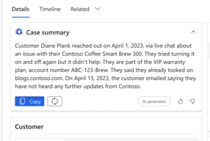
Copilot and AI innovation
Customer service
Summarize support cases with Copilot

Slide 52
Copilot and AI innovation
Customer service
Summarize conversations with Copilot
Generative AI is used to eliminate the need for agents to sift through lengthy transcripts, enabling them to deliver exceptional customer service in less time.
Quickly summarize conversations with generative AI.
Copilot automatically generates summaries of chat and transcribed voice conversations.
Public Preview: 2 Jun 2023
Early Access: -
General Availability: TBA

Slide 53
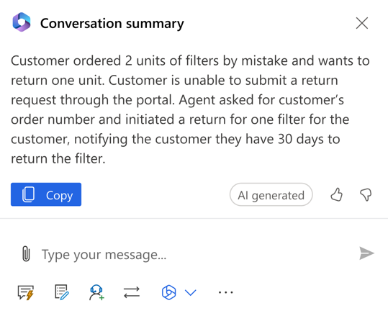
Copilot and AI innovation
Customer service
Summarize conversations with Copilot

Slide 54
Copilot and AI innovation
Customer service
View analytics for Copilot's impact on your business
Generative AI is used to create an impact across various tasks such as completing customer conversations, triaging and closing cases, and drafting and sending email.
The Copilot report in historical analytics helps users understand the impact Copilot helps create across these various modalities.
Key metrics: daily active users, percentage of copilot responses used, agent ratings, average handle time for conversations, average days to close for cases, average email response time.
Public Preview: Jun 2023
Early Access: -
General Availability: TBA

Slide 55
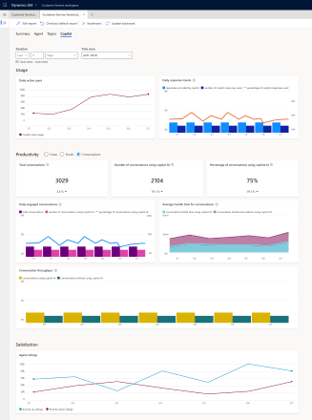
Copilot and AI innovation
Customer service
View analytics for Copilot's impact on your business

Slide 56
Copilot and AI innovation
Customer service
Discover knowledge content with Copilot
Agents spend a lot of time searching across multiple knowledge sources, consulting with subject matter experts to troubleshoot customer issues.
With this feature, agents can troubleshoot issues faster through a conversational chat experience with Copilot.
Link a Copilot conversation to a case automatically.
Refer the Copilot conversations that can now be stored in Dataverse.
Use the responses that are generated off of Dynamics 365 knowledge articles, external sources via knowledge integration, and trusted public websites.
Public Preview: 20 May 2023
Early Access: -
General Availability: TBA

Slide 57
Copilot and AI innovation
Customer service
Draft conversation replies with a click using Copilot
Generative AI is used to suggest a response that can be reviewed and sent to the customer over chat or other digital messaging channels, dramatically improving agent productivity and customer satisfaction.
Unified responses generated from internal document sources and external trusted public web sources.
The ability to view links to the sources that are referenced to produce the response.
Public Preview: 20 May 2023
Early Access: -
General Availability: TBA
Notes:
USA only

Slide 58
Copilot and AI innovation
Customer service
Draft email replies with a click using Copilot
With Copilot, customer service agents can craft personalized, contextual email replies with just a click.
Customer service agents can choose from predefined response prompts or even provide custom prompts for complex customer emails.
Draft replies with a click.
Select from predefined prompts and you'll have an email with a click. For the most complex situations, you can even provide your own custom prompt.
Public Preview: 20 May 2023
Early Access: -
General Availability: TBA
Notes:
USA only

Slide 59
Copilot and AI innovation
Customer service
Summary
Feature | Public Preview | Early Access | General Availability
Summarize support cases with Copilot | 19 May 2023 | - | TBA
Summarize conversations with Copilot | 2 Jun 2023 | - | TBA
View analytics for Copilot's impact on your business | Jun 2023 | - | TBA
Discover knowledge content with Copilot | 20 May 2023 | - | TBA
Draft conversation replies with a click using Copilot | 20 May 2023 | - | TBA
Draft email replies with a click using Copilot | 20 May 2023 | - | TBA
2023 Release Wave 1

Slide 60
Omnichannel
Customer service
Easily identify and diagnose problematic conversations
In addition to facilitating proactive system monitoring through self-service, the Azure Monitor also empowers IT professionals to easily identify and diagnose problematic conversations, helping self-remediate where possible or for seeking swift support.
This feature allows customers to access system telemetry for selective conversation lifecycle events from App Insights for live chat and digital messaging channels.
This information can be used in-app to monitor system health, as well as exported and combined with additional data sets to build custom dashboards.
Public Preview: Jul 2023
Early Access: -
General Availability: -

Slide 61
Omnichannel
Customer service
Customize, extend the conversation entity
To support functions beyond Customer Service like Sales, we now allow customers to link the conversation entity with other entities like leads and opportunities or any other custom entity.
Create custom fields, views, and charts.
Associate a conversation with a lead, opportunity, or any other entity enabled for activity.
Public Preview: -
Early Access: -
General Availability: 1 Apr 2023

Slide 62
Omnichannel
Customer service
Improved authentication in Apple Messages for Business
Auth V2 rich message support is required to maintain compliance with the Apple messaging service provider and continue offering the Apple Messages for Business channel.
The Apple Messages for Business messaging channel now allows you to send an authentication request to consumers using an OAuth 2.0 provider.
Public Preview: -
Early Access: -
General Availability: 1 Apr 2023

Slide 63
Omnichannel
Customer service
Make Customer Service workspace app available for omnichannel roles by default
Dynamics 365 Customer Service users with out-of-the-box omnichannel security roles will now have access to continued innovations in the Customer Service workspace app by default.
This feature release will make the Customer Service workspace app visible by default for the following roles:
Omnichannel agent
Omnichannel administrator
Omnichannel supervisor
Public Preview: -
Early Access: 6 Feb 2023
General Availability: 28 Apr 2023

Slide 64
Omnichannel
Customer service
Access renamed conversation forms
Simplifying form names helps users understand the purpose of forms when they accept and work on conversations.
Customer summary form has been renamed to Active Conversation form.
Conversation form has been renamed to Closed Conversation form.
Public Preview: -
Early Access: -
General Availability: 30 Apr 2023

Slide 65
Omnichannel
Customer service
Support regional voice fonts in voice channel
With this language expansion, you'll be able to greet customers with automated messages that use the voice font they are most used to.
We are expanding the support for languages in the voice channel to include more regional voice fonts such as English-United Kingdom, English-Australia, English-New Zealand, Spanish-Mexico, Spanish-United States, and French-Canada.
These voice fonts can be used seamlessly with Power Virtual Agents bots.
Public Preview: -
Early Access: -
General Availability: 2 Jun 2023

Slide 66
Omnichannel
Customer service
Integrate Nuance Gatekeeper with Customer Service
Reduce fraud and improve trust and customer experience to bring operational efficiency in contact centres.
Voice biometric authentication for contacts allowing secure transactions to be confirmed without sharing of personal data.
Fraud prevention capabilities alert agents about known fraudsters and spoofing attempts and allow agents to flag conversations for further investigation by a fraud analyst.
Supervisors can monitor conversations flagged as suspicious or fraudulent.
Integrated reporting for fraud analysis.
Public Preview: Jul 2023
Early Access: -
General Availability: TBA
Notes:
USA only

Slide 67
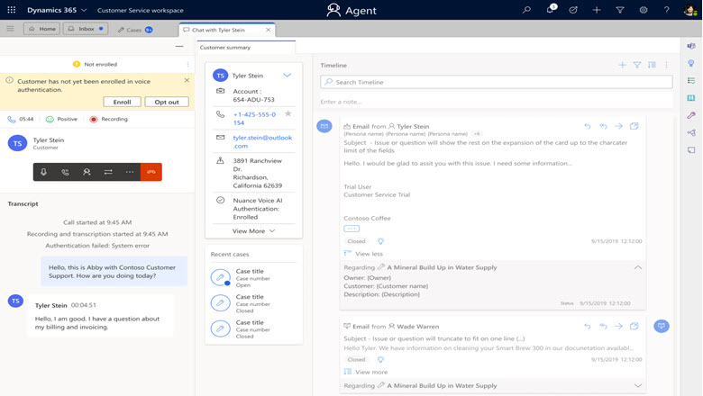
Omnichannel
Customer service
Integrate Nuance Gatekeeper with Customer Service

Slide 68
Omnichannel
Customer service
Summary
Feature | Public Preview | Early Access | General Availability
Easily identify and diagnose problematic conversations | Jul 2023 | - | -
Customize, extend the conversation entity | - | - | 1 Apr 2023
Improved authentication in Apple Messages for Business | - | - | 1 Apr 2023
Make Customer Service workspace app available for omnichannel roles by default | - | 6 Feb 2023 | 28 Apr 2023
Access renamed conversation forms | - | - | 30 Apr 2023
Support regional voice fonts in voice channel | - | - | 2 Jun 2023
Integrate Nuance Gatekeeper with Customer Service | Jul 2023 | - | TBA
2023 Release Wave 1

Slide 69
Supervisor experiences
Customer service
Customize visualization of omnichannel real-time analytics dashboards
With this feature, administrators can customize reports to meet their organizational requirements by leveraging the out-of-the-box real-time Power BI-embedded data model.
Rearrange the out-of-the-box report layout on omnichannel real-time analytics.
Modify the graphical rendering of data. For example, you can have a graphic with the trend of a metric over time rather than a tabular view of the metric.
Create visuals using metrics in the data model that aren't exposed directly in the out-of-the-box Power BI reports.
Public Preview: 31 Oct 2022
Early Access: -
General Availability: 30 Apr 2023

Slide 70
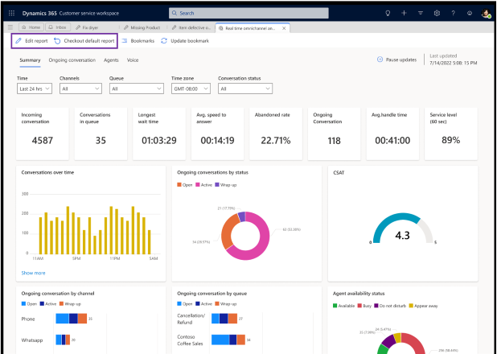
Supervisor experiences
Customer service
Customize visualization of omnichannel real-time analytics dashboards

Slide 71
Supervisor experiences
Customer service
Monitor support operations in near real-time
Having visibility into the overall support performance through near real-time reporting empowers managers to monitor key operational metrics, make course corrections at the right time, and keep service levels high.
Summary report.
Agent report.
Voice report.
Conversation list.
Visual customisation.
Personalisation.
Auto refresh/Pause refresh.
Public Preview: 31 Oct 2022
Early Access: -
General Availability: 30 Apr 2023

Slide 72
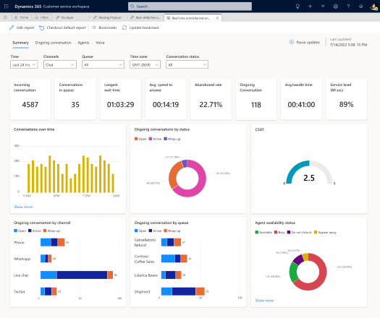
Supervisor experiences
Customer service
Monitor support operations in near real-time

Slide 73
Supervisor experiences
Customer service
Personalize out-of-the-box real-time analytics reports
You can now use the out-of-the-box real-time reports with your selected filters by saving them as bookmarks. This helps personalize your reports and saves the time and effort required to reapply the filters every time you open the dashboards.
Save filters as bookmarks for out-of-the-box reports.
Select from a previously saved filter list (bookmarks) to view metrics based on the filters.
Set one of the bookmarks as default.
Delete one or multiple bookmarks.
Public Preview: 31 Oct 2022
Early Access: -
General Availability: 30 Apr 2023

Slide 74
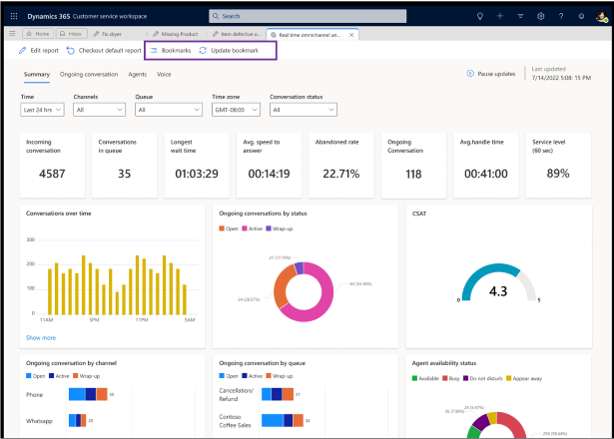
Supervisor experiences
Customer service
Personalize out-of-the-box real-time analytics reports

Slide 75
Supervisor experiences
Customer service
Summary
Feature | Public Preview | Early Access | General Availability
Customize visualization of omnichannel real-time analytics dashboards | 31 Oct 2022 | - | 30 Apr 2023
Monitor support operations in near real-time | 31 Oct 2022 | - | 30 Apr 2023
Personalize out-of-the-box real-time analytics reports | 31 Oct 2022 | - | 30 Apr 2023
2023 Release Wave 1

Slide 76
Teams integration
Customer service
Use customer support swarming for complex cases
Customer support swarming enables agents to bring together the right experts across their organization to resolve complex cases faster.
During the swarm configuration, administrators will no longer have to manually activate the case form for swarming.
The swarm form is now customizable.
The swarm creation form now comes with an advanced look and feel.
Agents will no longer have to manually type the swarm title.
Public Preview: 6 Apr 2023
Early Access: -
General Availability: -

Slide 77
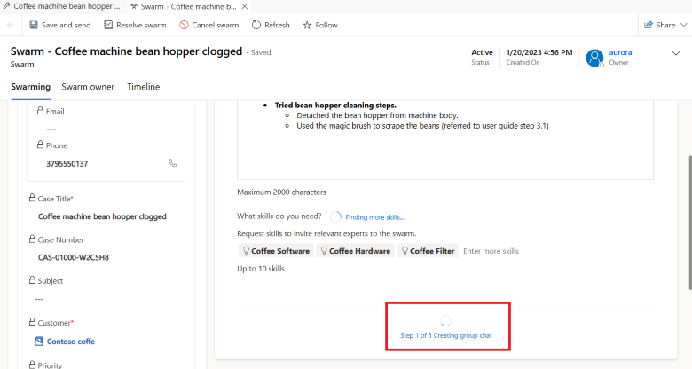
Teams integration
Customer service
Use customer support swarming for complex cases

Slide 78
Teams integration
Customer service
View Teams chat on the connected record's timeline
Make it easy for agents to get the full case 360 view by allowing them to see any chats related to the case (or any record) directly on the timeline.
When starting a connected chat or connecting an existing chat to a record, agents will see the conversation appear as a new activity on the timeline.
If agents change, the new agent, who may not have been a part of the chat initially, can also see the conversation on the timeline.
Public Preview: 7 Apr 2023
Early Access: -
General Availability: -

Slide 79
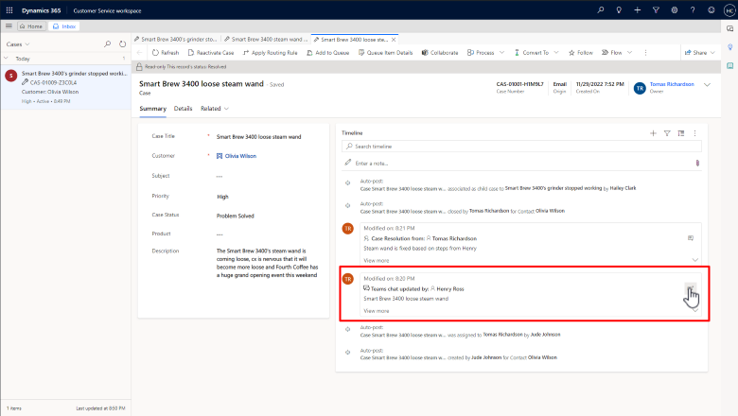
Teams integration
Customer service
View Teams chat on the connected record's timeline

Slide 80
Teams integration
Customer service
Swarms are auto-resolved or -cancelled when parent case is closed or cancelled
When a parent case is closed, the associated swarms should be considered addressed.
Rather than requiring agents to manually resolve or cancel these swarms, the built-in automation will do it for them.
Links will help agents navigate to the open swarms with a message that clearly indicates the call to action and results.
Agents can make a selection to confirm or cancel the swarms.
If the agent confirms, the associated swarms will be resolved or cancelled.
If the agent selects cancel, they'll be returned to the case form.
Public Preview: 12 May 2023
Early Access: -
General Availability: -

Slide 81
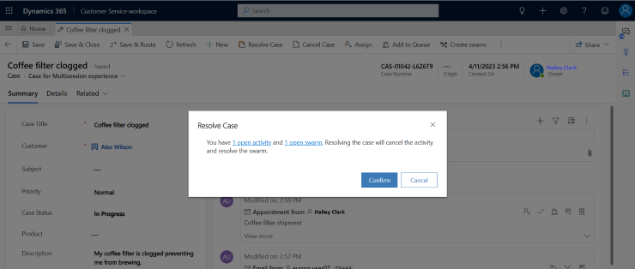
Teams integration
Customer service
Swarms are auto-resolved or -cancelled when parent case is closed or cancelled

Slide 82
Teams integration
Customer service
Dynamics 365 links are unfurled in Teams chats
See the details of your business data in your Microsoft Teams chats and feel confident that the link you're selecting is an authentic Power Apps link.
Now, when you paste a Dynamics 365 Customer Service link into a Microsoft Teams chat, meeting, or channel, it'll automatically be unfurled in an adaptive card.
Public Preview: -
Early Access: 6 Feb 2023
General Availability: 3 Apr 2023

Slide 83
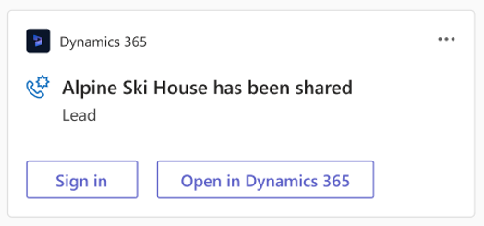
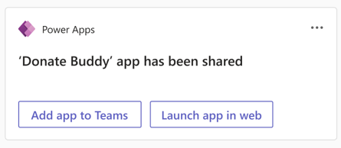
Teams integration
Customer service
Dynamics 365 links are unfurled in Teams chats

Slide 84
Teams integration
Customer service
Keep chat participants informed when fields are updated
Reduce the overhead on agents by automatically updating all chat participants when an essential field on a connected record is updated.
You can also keep agents informed when things on the record change.
Public Preview: -
Early Access: -
General Availability: 26 May 2023

Slide 85
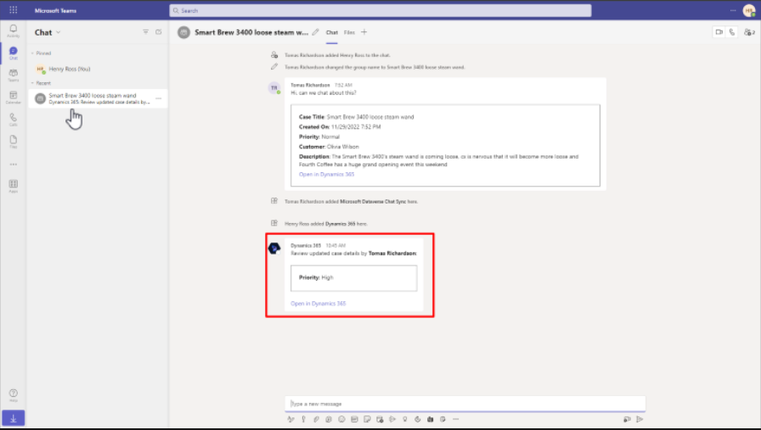
Teams integration
Customer service
Keep chat participants informed when fields are updated

Slide 86
Teams integration
Customer service
Summary
Feature | Public Preview | Early Access | General Availability
Use customer support swarming for complex cases | 6 Apr 2023 | - | -
View Teams chat on the connected record's timeline | 7 Apr 2023 | - | -
Swarms are auto-resolved or -cancelled when parent case is closed or cancelled | 12 May 2023 | - | -
Dynamics 365 links are unfurled in Teams chats | - | 6 Feb 2023 | 3 Apr 2023
Keep chat participants informed when fields are updated | - | - | 26 May 2023
2023 Release Wave 1

Slide 87
Unified routing
Customer service
Show number of users in queues in routing rules setup
The message helps contact centre administrators avoid routing conversations to queues that contain no users, and ensures conversations are always assigned to users.
While configuring routing rule conditions, when administrators select a target queue, the number of users in each queue will be displayed in the queue selection box. If no users are in a queue, a warning message will be displayed that the queue doesn't have users.
Public Preview: -
Early Access: -
General Availability: 28 Apr 2023

Slide 88
Unified routing
Customer service
Enhancements in assignment diagnostics
Administrators and supervisors will have improved visibility and transparency of assignment status for better decision making and increased productivity in customer service.
With this feature enhancement, administrators will be able to view the assignment attempt details within Agent assignment trace in the diagnostics record.
Public Preview: -
Early Access: -
General Availability: 30 Apr 2023

Slide 89
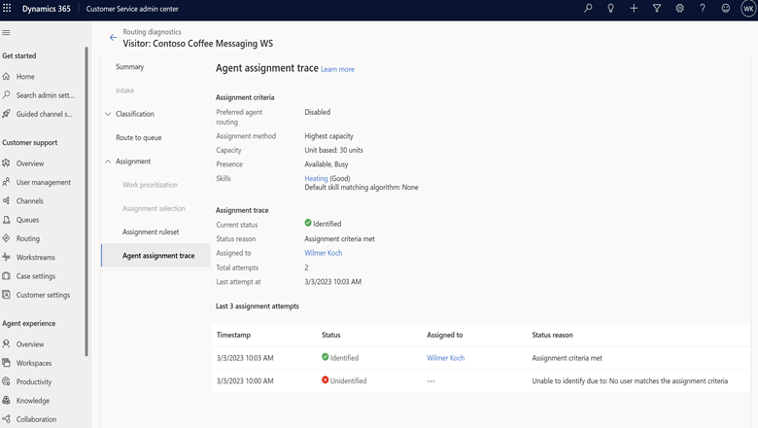
Unified routing
Customer service
Enhancements in assignment diagnostics

Slide 90
Unified routing
Customer service
Optimizations in automatic assignment of work items
Enhancements in automatic assignment help offer agents the same work items that couldn't be assigned previously because the assignment request timed out or the agents had rejected the assignment.
Agents will be offered the same work item by the automatic assignment engine up to three times, each time giving agents the option to reject the work before the request times out.
Supervisors and other agents can still assign a work item to an agent who previously rejected it three times.
Public Preview: -
Early Access: -
General Availability: 30 Apr 2023

Slide 91
Unified routing
Customer service
Manage skills with enhancements in user experience
For efficient routing in the customer service centres, the administrators should be able to quickly set up skills, queues, and capacity profiles for users, manage them for multiple users, and modify the workforce based on the fluctuations in demand.
Set up a skills-based workforce.
Select multiple users and manage their skills, queues, and capacity profiles.
Manipulate the users' skills and queues to meet the fluctuations in demand.
Public Preview: -
Early Access: -
General Availability: 15 May 2023

Slide 92
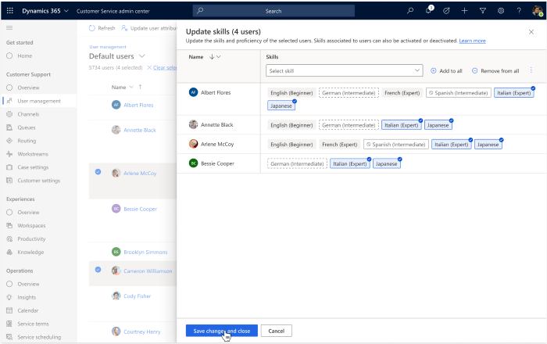
Unified routing
Customer service
Manage skills with enhancements in user experience

Slide 93
Unified routing
Customer service
Summary
Feature | Public Preview | Early Access | General Availability
Show number of users in queues in routing rules setup | - | - | 28 Apr 2023
Enhancements in assignment diagnostics | - | - | 30 Apr 2023
Optimizations in automatic assignment of work items | - | - | 30 Apr 2023
Manage skills with enhancements in user experience | - | - | 15 May 2023
2023 Release Wave 1

Slide 94
Customer Service
2023
Wave Release 1
Administrator experiences
An intuitive, modern administration experience is key to quickly setting up D365 Customer Service and using its features.
Agent experiences
Enable agents to handle multiple interactions, interact with multiple apps without losing context, and enhance workflows with productivity tools.
Copilot and AI innovation
Copilot in D365 Customer Service consists of a range of AI capabilities that can expedite the resolution of customer issues and increase satisfaction.
Omnichannel
Enables instant engagement and connectivity between agents and customers and gives supervisors real-time visibility into operational efficiency.

Slide 95
Customer Service
2023
Wave Release 1
Developer experiences
Use developer capabilities to extend the features by building advanced customizations to suit your business needs.
Teams integration
Provide agents with seamless integrations between Dynamics 365 and Microsoft Teams.
Unified routing
Intelligent work item classification and omnichannel routing capabilities enable the flexibility and automation of AI-enabled workflows.

Slide 96
Administrator experiences
Customer service
Use overflow to handle lengthy wait times for queues
To improve customer satisfaction, contact centres need to automatically transfer work items to other queues or direct customers to voicemail if the wait time is too long.
Set a clear and reasonable wait time limit for work items before they will be marked for overflow.
Define a contingency plan for work items that exceed the wait time limit, such as transfer them to another queue with more agents who can address the customer request, send the call to voicemail, or arrange for a direct callback.
Public Preview: Oct 2023
Early Access: -
General Availability: -

Slide 97
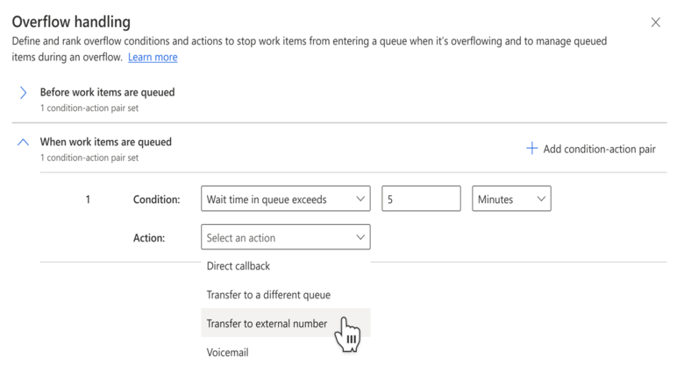
Administrator experiences
Customer service
Use overflow to handle lengthy wait times for queues

Slide 98
Administrator experiences
Customer service
Summary
Feature | Public Preview | Early Access | General Availability
Use overflow to handle lengthy wait times for queues | Oct 2023 | - | -
2023 Release Wave 2

Slide 99
Agent experiences
Customer service
Improved search control to manage subjects
With this feature, we're implementing the improved subject control to all forms that will make it easier to view and search the subject tree hierarchy.
Easy-to-view subject tree hierarchy.
Ability to search across parent subjects and child nodes.
Highlight search results.
Public Preview: -
Early Access: Jul 2023
General Availability: Oct 2023

Slide 100
Agent experiences
Customer service
Show agents their live chats and voice calls in the inbox
The inbox centralizes the agent's work on their live chats and calls, alongside cases, emails, voicemails, and asynchronous chats in a single view so that they can increase their productivity.
Routing of live work items to the agent's inbox
View of live work items in a focused "live" section
Agent ability to see live chat and voice call views
Card layouts for live chat and voice that display key information
Public Preview: -
Early Access: -
General Availability: Oct 2023

Slide 101
Agent experiences
Customer service
New call control user interface with intuitive icons for voice channel
The new Conversation control interface has intuitive icons with descriptions that help agents understand the use of the icons without having to hover over it.
Bigger icons that occupy the standardized grid of the conversation panel.
Icons have a description to help agents understand the icon's intended action without hovering over it.
The Transfer and Consult icons are the most used icons and are available next to the customer's name.
Public Preview: -
Early Access: Jul 2023
General Availability: Oct 2023

Slide 102
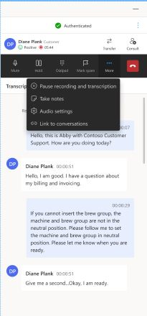
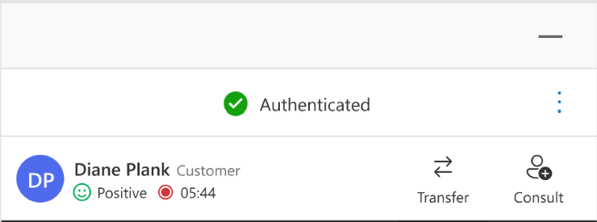
Agent experiences
Customer service
New call control user interface with intuitive icons for voice channel

Slide 103
Agent experiences
Customer service
Conversation-centric agent experience for channels
This feature allows agents to personalize the size of the conversation control when using Customer Service workspace.
Agents interacting with the communication panel will be able to set the conversation control size for a given channel, per their preference.
Public Preview: Aug 2023
Early Access: -
General Availability: Oct 2023

Slide 104
Agent experiences
Customer service
Summary
Feature | Public Preview | Early Access | General Availability
Improved search control to manage subjects | - | Jul 2023 | Oct 2023
Show agents their live chats and voice calls in the inbox | - | - | Oct 2023
New call control user interface with intuitive icons for voice channel | - | Jul 2023 | Oct 2023
Conversation-centric agent experience for channels | Aug 2023 | - | Oct 2023
2023 Release Wave 2

Slide 105

Copilot and AI innovation
Customer service
Carried over from previous wave
Summarize support cases with Copilot
Generative AI is used to eliminate the need for agents to read lengthy case details, notes, and email threads, enabling them to deliver exceptional customer service in less time.
A simple-to-read natural language summary
The ability for agents to regenerate a summary on demand
A simple and extendable case summary
Experience component to integrate with custom forms
Public Preview: 19 May 2023
Early Access: -
General Availability: Oct 2023

Slide 106
Copilot and AI innovation
Customer service
Summarize support cases with Copilot

Slide 107
Copilot and AI innovation
Customer service
Carried over from previous wave
Summarize conversations with Copilot
Generative AI is used to eliminate the need for agents to sift through lengthy transcripts, enabling them to deliver exceptional customer service in less time.
Quickly summarize conversations with generative AI.
Copilot automatically generates summaries of chat and transcribed voice conversations.
Public Preview: 2 Jun 2023
Early Access: -
General Availability: Oct 2023

Slide 108
Copilot and AI innovation
Customer service
Summarize conversations with Copilot

Slide 109
Copilot and AI innovation
Customer service
Carried over from previous wave
View analytics for Copilot's impact on your business
Generative AI is used to create an impact across various tasks such as completing customer conversations, triaging and closing cases, and drafting and sending email.
The Copilot report in historical analytics helps users understand the impact Copilot helps create across these various modalities.
Key metrics: daily active users, percentage of copilot responses used, agent ratings, average handle time for conversations, average days to close for cases, average email response time.
Public Preview: Jun 2023
Early Access: -
General Availability: Oct 2023

Slide 110
Copilot and AI innovation
Customer service
View analytics for Copilot's impact on your business

Slide 111
Copilot and AI innovation
Customer service
Carried over from previous wave
Discover knowledge content with Copilot
Agents spend a lot of time searching across multiple knowledge sources, consulting with subject matter experts to troubleshoot customer issues.
With this feature, agents can troubleshoot issues faster through a conversational chat experience with Copilot.
Link a Copilot conversation to a case automatically.
Refer the Copilot conversations that can now be stored in Dataverse.
Use the responses that are generated off of Dynamics 365 knowledge articles, external sources via knowledge integration, and trusted public websites.
Public Preview: 20 May 2023
Early Access: -
General Availability: Jan 2024

Slide 112
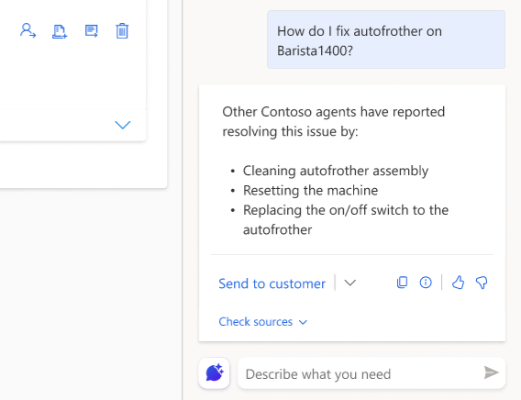
Copilot and AI innovation
Customer service
Discover knowledge content with Copilot

Slide 113
Copilot and AI innovation
Customer service
Carried over from previous wave
Draft email replies with a click using Copilot
With Copilot, customer service agents can craft personalized, contextual email replies with just a click.
Customer service agents can choose from predefined response prompts or even provide custom prompts for complex customer emails.
Draft replies with a click.
Select from predefined prompts and you'll have an email with a click. For the most complex situations, you can even provide your own custom prompt.
Public Preview: 20 May 2023
Early Access: -
General Availability: Jan 2024
Notes:
USA only

Slide 114
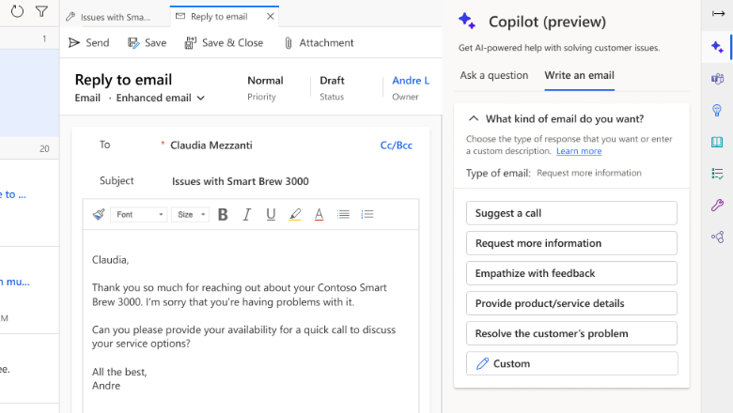
Copilot and AI innovation
Customer service
Draft email replies with a click using Copilot

Slide 115
Copilot and AI innovation
Customer service
Carried over from previous wave
Draft conversation replies with a click using Copilot
Generative AI is used to suggest a response that can be reviewed and sent to the customer over chat or other digital messaging channels, dramatically improving agent productivity and customer satisfaction.
Unified responses generated from internal document sources and external trusted public web sources.
The ability to view links to the sources that are referenced to produce the response.
Public Preview: 20 May 2023
Early Access: -
General Availability: Jan 2024
Notes:
USA only

Slide 116
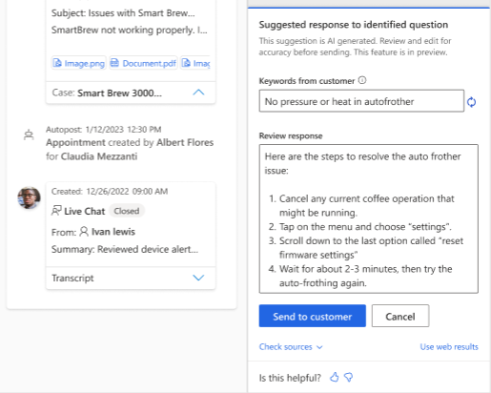
Copilot and AI innovation
Customer service
Draft conversation replies with a click using Copilot

Slide 117
Copilot and AI innovation
Customer service
Summary
Feature | Public Preview | Early Access | General Availability
Summarize support cases with Copilot | 19 May 2023 | - | TBA
Summarize conversations with Copilot | 2 Jun 2023 | - | TBA
View analytics for Copilot's impact on your business | Jun 2023 | - | TBA
Discover knowledge content with Copilot | 20 May 2023 | - | TBA
Draft conversation replies with a click using Copilot | 20 May 2023 | - | TBA
Draft email replies with a click using Copilot | 20 May 2023 | - | TBA
2023 Release Wave 2

Slide 118
Omnichannel
Customer service
Improvements to the call dialler
An intuitive and efficient dialler to make phone calls is required for agents who have to communicate with customers on the phone.
Number typing and editing
Number formatting
Number country detection
Contact lookup
Contact management
Agents can select the outbound number to call with
Public Preview: Oct 2023
Early Access: -
General Availability: -
Notes:
USA only

Slide 119
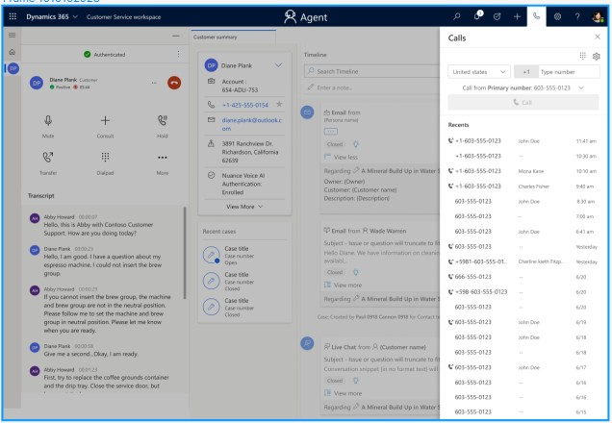
Omnichannel
Customer service
Improvements to the call dialler

Slide 120
Omnichannel
Customer service
Transfer calls to Teams users without phone numbers
You can now take full advantage of all experts you may have on Teams, with or without phone numbers. You'll also pay less to have them on the call (only a third of the current cost).
Use Voice over Internet Protocol (VOIP) to contact Teams users in your tenant.
VOIP costs a third of the price to have the Teams user on the call today.
Teams users are no longer required to have a phone number.
Public Preview: Nov 2023
Early Access: -
General Availability: -
Notes:
USA only

Slide 121
Omnichannel
Customer service
Monitor operational telemetry through Application Insights
By integrating Omnichannel for Customer Service with Application Insights, customers can now access self-serve information to monitor operational telemetry, troubleshoot issues, and understand the root cause to guide their mitigation plan.
Access granular information for behind-the-scene operations.
Leverage configurability to create custom diagnostic events and log telemetry
Public Preview: Jul 2023
Early Access: -
General Availability: Oct 2023
Notes:
USA only

Slide 122
Omnichannel
Customer service
Enhanced security with OAuth 2.0 support in live chat
With OAuth 2.0, businesses can offer the chat channel to their customers with enhanced security for improved customer privacy and information security.
The Omnichannel administrator can configure live chat to use an OAuth 2.0 authorization code flow and accept fields that are commonly used in an OpenID integration with most identity providers.
The web developer who implements the live chat widget on your website can pass an authorization code through as a part of the authentication flow.
You can set up a custom action in your Dynamics 365 instance to identify the contact related to the authorized user.
Public Preview: -
Early Access: -
General Availability: Oct 2023
Notes:
USA only

Slide 123
Omnichannel
Customer service
Caller ID number support for outbound calls
Use of caller IDs for names and numbers is a standard way to be recognized as a legitimate caller for customers. In privacy-sensitive areas, supporting anonymous calling is critical.
The outbound caller ID, company name, and numbers should be displayed to customers in the following scenarios:
During customer callbacks.
If an agent makes an outbound call.
If an agent transfers a call, for example, to an external number.
Public Preview: -
Early Access: -
General Availability: Oct 2023
Notes:
USA only

Slide 124
Omnichannel
Customer service
Enable VDI support on Azure Virtual Desktop for Omnichannel Voice
By deploying the voice channel in Customer Service via remote desktops, businesses gain significant IT cost savings in providing standardized and secure agent desktops.
Organizations are moving to Azure Virtual Desktop for access to tools and services that are needed to support their customers for better management and control of their agent devices.
Public Preview: Jul 2023
Early Access: -
General Availability: Dec 2023
Notes:
USA only

Slide 125
Omnichannel
Customer service
Extend emergency calling to Canada
The ability to use emergency calling services, also known as E911, is a critical feature to ensure business compliance.
In 2023 release wave 2, the support for emergency calling E911 for direct offer numbers in Canada will be available.
Public Preview: Oct 2023
Early Access: -
General Availability: Feb 2024
Notes:
USA only

Slide 126
Omnichannel
Customer service
Summary
Feature | Public Preview | Early Access | General Availability
Improvements to the call dialler | Oct 2023 | - | -
Transfer calls to Teams users without phone numbers | Nov 2023 | - | -
Monitor operational telemetry through Application Insights | Jul 2023 | - | Oct 2023
Enhanced security with OAuth 2.0 support in live chat | - | - | Oct 2023
Caller ID number support for outbound calls | - | - | Oct 2023
Enable VDI support on Azure Virtual Desktop for Omnichannel Voice | Jul 2023 | - | Dec 2023
Extend emergency calling to Canada | Oct 2023 | - | Feb 2024
2023 Release Wave 2

Slide 127
Developer experiences
Customer service
Use agent availability API for unauthenticated chats
Improve customer experience by minimizing wait times and optimize service support by checking the availability of agents for unauthenticated chats that would otherwise be in the queue for a longer duration.
The agent availability API that's available to use for authenticated chats to determine availability of agents in the queue is now extended to unauthenticated chats also.
Public Preview: Sep 2023
Early Access: -
General Availability: Jan 2024
Notes:
USA only

Slide 128
Developer experiences
Customer service
Summary
Feature | Public Preview | Early Access | General Availability
Use agent availability API for unauthenticated chats | Sep 2023 | - | Jan 2024
2023 Release Wave 2

Slide 129
Teams integration
Customer service
Collaborate using Teams embed chat without having to enable it
We've made collaboration easier in Dynamics 365 Customer Service by making experiences such as embed chat the default setting rather than requiring an admin to turn them on.
You no longer need a global tenant admin to turn on the Teams collaboration feature, embed chat.
Public Preview: Jul 2023
Early Access: -
General Availability: Oct 2023
Notes:
USA only

Slide 130
Teams integration
Customer service
Summary
Feature | Public Preview | Early Access | General Availability
Collaborate using Teams embed chat without having to enable it | - | Jul 2023 | Oct 2023
2023 Release Wave 2

Slide 131
Unified routing
Customer service
Route calls to agents who are idle for longest period
Organizations can route phone calls to agents who have been idle or least active for the longest duration to ensure better use of agents.
Least Active will be the default assignment method for new voice queues. The selection for existing voice queues will remain unchanged.
Public Preview: -
Early Access: -
General Availability: Oct 2023
Notes:
USA only

Slide 132
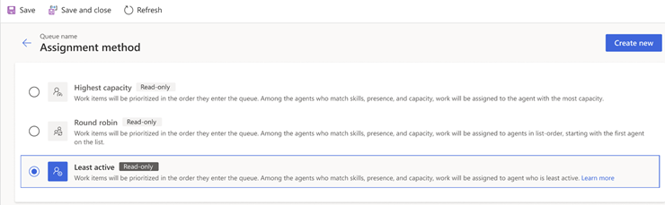
Unified routing
Customer service
Route calls to agents who are idle for longest period

Slide 133
Unified routing
Customer service
Summary
Feature | Public Preview | Early Access | General Availability
Route calls to agents who are idle for longest period | - | - | Oct 2023
2023 Release Wave 2

